Slide 1

Sustainable Development Goals (SDGs)
Medium to long term planning is capable of producing insights that can inform policies related to SDGs

Slide 2
Sustainable Development Goals (SDGs)
Illustrative linkages between SDGs

Slide 3
Sustainable Development Goals (SDGs)
SDG 7: Ensure access to affordable, reliable, sustainable and modern energy for all
Given the present status and expected future energy demands, it is necessary to plan ahead how the energy resources could be used to meet the demands, in the near and far future.

Slide 4
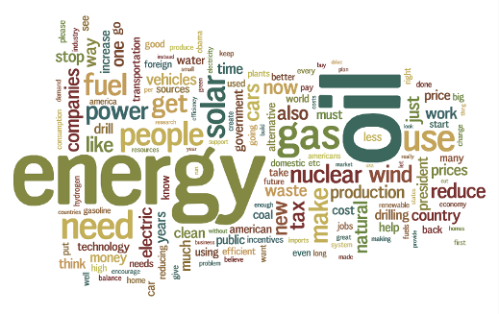
Energy policy
Energy policy is the manner in which a given entity has decided to address issues of energy planning including energy supply, distribution and end-use.
It includes aspects related to:
Energy security
Environmental protection
Market structures
Incentives or disincentives (e.g., FITs, carbon taxes)
Directives (e.g. measure for efficiency improvements)

Slide 5
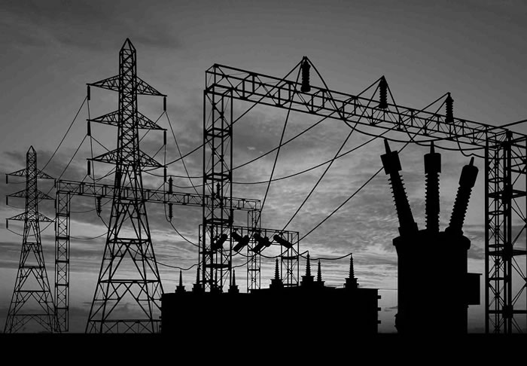
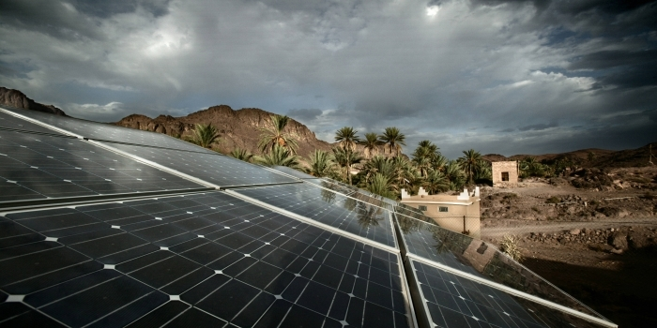
Examples of energy policy questions
What needs to be done and what will be the costs to supply modern energy sources to remote areas?
What if environmental regulations are made more stringent?
What needs to be done to increase the share of renewable technologies?
Should electricity import be allowed?
Should existing nuclear facilities be closed down?
Can an energy conservation program help in reducing cost of energy supply?

